Slide 1

WiSo-Graduate School Information on PhD-education
-
H
-
- Recht

Slide 2
TOPICS
WiSo-Graduate School
Enrollment to the university
Admission to the WiSo-Graduate School
Graduate School: Doctoral degree regulations
Graduate School: Doctoral program
Financial support
http://www.wiso.uni-hamburg.de/einrichtungen/graduate-school/startseite/

Slide 3
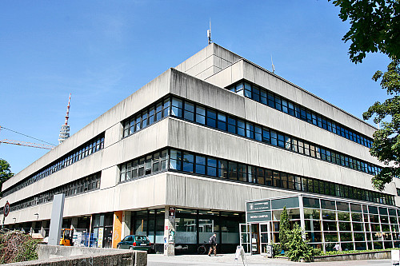
Main Building of the WiSo-Faculty
WiSo-Graduate School

Slide 4
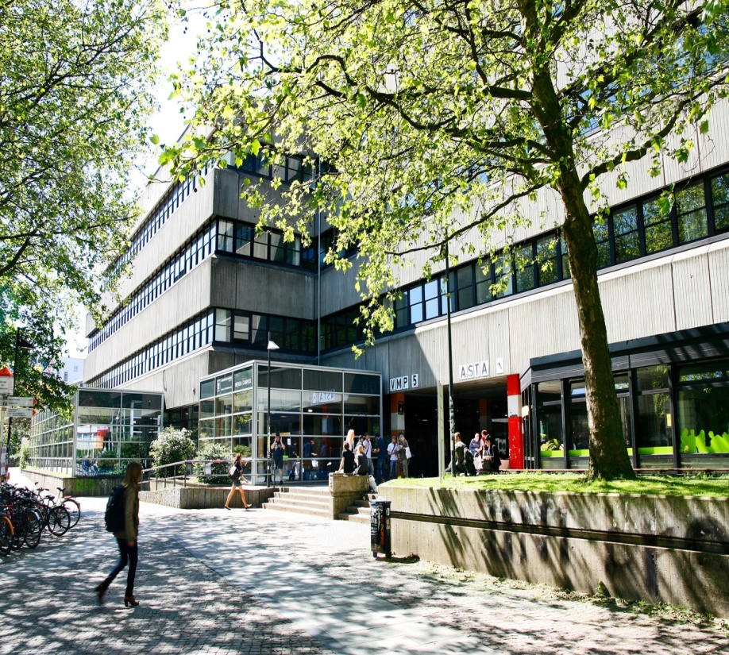
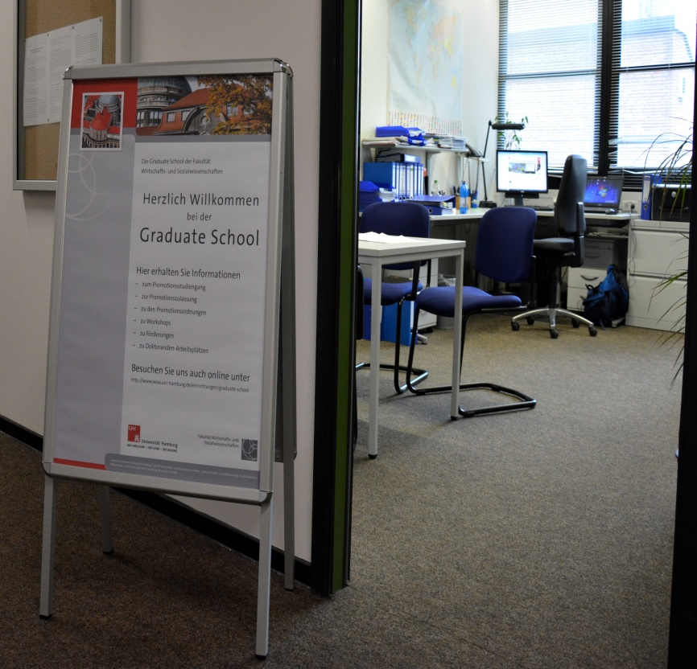
Graduate School WiSo-Faculty
WiSo-Graduate School

Slide 5

WiSo-Graduate School: Data, Figures and Facts
  Students at the WiSo-Faculty: ca. 6.000
  465 doctoral students (Proportion of women: 45%; Proprotion of foreigners: 25%)
  75 Professors
  Fondation of the GS: 2009
  Three departments:
    Department of Social Sciences <---- GIGA
    Department Socioeconomics
    Department of Economics
Seite 5

Slide 6
GS-Fields and Number of Doctorands (Status: 01.04.2015)
WiSo-Graduate School

Slide 7
Graduate School - Staff and Structure
WiSo-Graduate School
GS-Office
GS-Board
1 Managing Director (Dr. Ulf Beckmann)
2 Consultants (Marisa Shabaz and Claudia Salinger)
2 Student Assistants (part-time)
Total: 3,5 employees
4 Professors
(1 Prof per department plus
Dean of Research)
1 Postdoc
1 Doctoral Student
GS-Managing Director
Total: 7 Members
GS-Director: Prof. Dr. Timo Busch

Slide 8
Enrollment at the University of Hamburg:
First step: “Conditional“ Enrollment (I)
1.) GIGA-Doctoral student looks for a supervisor (a professor of the faculty of Business, Economics and Social Sciences of the University of Hamburg)
2.) Supervisor („Doktorvater“ or „Doktormutter“) fills out the
„Betreuungserklärung“ (supervision declaration).
3.) GiGA-Doctoral student visits the Graduate School, presents the „Betreuungserklärung“ and a certified copy of Diploma or masters degree
4.) GS then fills out the „Betreuungsbescheinigung“ (supervision confirmation)

Slide 9
„Conditional“ Enrollment (II)
WiSo-Graduate School
4.) Present the „Betreuungsbescheinigung“ at the „Campus Center“ (Ms. Regina Brock, Alsterterrasse 1) and also a print-out of your application from the application platform (register under: www.uni-hamburg.de/online-bewerbung), a certified copy of Diploma or masters degree and a proof of health insurance)
5.) Pay the semester fee (semester contribution, especially for the semester ticket): 305,00 Euro
6.) Enrollment for max. two semesters with „bedingter Immatrikulation“ (conditional enrollment)
Seite 9

Slide 10
Second step: Admission to the Graduate School and „Final“ Enrollment (I)
WiSo-Graduate School
1.) GIGA’s Miriam Prys or Ina Peters send a list with the new doctoral GIGA-Students to the Graduate School.
2.) Admission to the Graduate School: If you have a supervisor from the WiSo-Faculty, you make an application for the admission at the GS with the help of the new Graduate School-IT-system “Docata” (see GS-Webpage or GS-information sheet)
https://docata.wiso.uni-hamburg.de/welcome

Slide 11
Second step: Admission to the Graduate School and „Final“ Enrollment (II)
WiSo-Graduate School
3.) a) In Docata: please fill out:
- Personal data
- Names of the first and the second supervisor
- Working title of your dissertation
- synopsis (exposé) of the dissertation about 5 to 15 pages
- line of questionning
- sketch of the current state of research
- time-line and workplan
- declaration Dr. phil. or Dr. rer.pol.

Slide 12
Second step: Admission to the Graduate School and „Final“ Enrollment (III)
WiSo-Graduate School
3.) b) In Docata: please upload:
- Bachelor and Master transcripts and certificates
- Supervision agreement
4.) Please print out the “docata”-application and submit it with the CV, the exposé, the supervision agreement and the certificates and transcripts of the bachelor and master degrees at the Graduate School (Ms. Shabaz)
5.) And then you are accepted at the Graduate School and to the doctoral studies program – according to a cooperation agreement between GS and GIGA)

Slide 13
Second step: Admission to the Graduate School and „Final“ Enrollment (IV)
WiSo-Graduate School
6.) Graduate School fills out the „Zulassungsbescheinigung“ (admission letter)
and sends it to the GIGA-doctoral student and the Campus Center.
7.) With receiving the „Zulassungsbescheinigung“ the doctoral candidate is completely enrolled (“final enrollment”)

Slide 14
Admission to Graduate School without a WiSo-Supervisor
WiSo-Graduate School
1.) If you don´t have a supervisor from the WiSo-Faculty, you send an e-mail to Ulf Beckmann, that you want to be a “guest doctoral student” at the Graduate School.
2.) The Graduate School then admits you as a “guest doctoral student” and you can take part at the Graduate School courses.

Slide 15

Doctoral degree Regulations – important regulations (I)
WiSo-Graduate School
  Supervisory committee and Examination Committee
  - 1. Supervisor = 1. Evaluator/Reviewer
  - 2. Supervisor ǂ 2. Evaluator/Reviewer
  Composition of the Examination Committee
  - 1. Evaluator/Reviewer
  - 2. Evaluator/Reviewer
  - 2. Supervisor
  - Chair of the Examination Committee
  Right of proposal: The candidate can propose all the candidates of the examination committee

Slide 16
Doctoral degree Regulations – important regulations (II)
WiSo-Graduate School
  Monograph or cumulative Dissertation
  - at least three papers
  - published and/or unpublished - Co-Author is possible
  - at least 1 paper must be written independently by the candidate
  - at least 1 evaluator must not habe been Co-Author
  - the other evaluator may have co-authored a maximum of half the submitted individual papers.

Slide 17
Doctoral Program
WiSo-Graduate School
  Start: WiSe 12/13
  Ca. 20 SWS per Semester
  Topics:
  - Theories of economics and social sciences
  - Research Methods (focus!)
  - Key kompetences
  Professors of the faculty do the teaching
  At least you have to receice 12 Credit Points (ECTS-Points)
  Generous recognition of other activities (par example: teaching activities, presentation at conferences, summer schools etc.)
Seite 17

Slide 18

Courses
WiSo-Graduate School
  Type of course: Workshops or Seminars → workshops weekly or block seminars
  No mandatory ourses
  Weekly hours per Semester (SWS) and Credits (LP):
  As a rule:
  1 SWS = 2 LP
  2 SWS = 4 LP
  Number of participants:
  10 to 20 doctoral students (at least: five)
Seite 18

Slide 19
Courses in WiSe 15/16 (I)
WiSo-Graduate School
  Methods:
  MAXQDA Complete (Dresing), 19.11. und 20.11.15 (german)
  Applied Macroeconometrics (Fritsche), 14./15.01.16 und 21./22.01.16 (engl.)
  Science in R (Hawes), Tues, 10 – 12 Uhr (weekly, start: 13.10.15) (engl.)
  Behavioral Political Economics (Mechtenberg), Thurs, 10 – 14 Uhr (14tägig, start: 22.10.15) (engl.)
  Stochastic Dynamic Programming (Posch), Fri., 09-12 Uhr (weekly 13.11.15 – 29.01.16) (engl.)
  Qualitative Verfahren der Datenauswertung (Schiek), 13.11.15, 27./28.11.15 und 11.12./12.12.15 (german)
  Statistical Analysis with STATA (Schnapp), 22.02.16 – 26.02.16 (german or english)
  Einführung in LaTex, 18.02.16 (german or english)
Seite 19

Slide 20
Courses in WiSe 15/16 (II)
WiSo-Graduate School
  Theories:
  Behavioral Game Theory (Bayer), 04.11.15 – 06.11.15, 18./19.11.15, 25./26.11.15 (engl.)
  Key Competences:
  Projektmanagement & Auftragsforschung (Braun/Wiesner), 14./15.09.15 (already taken place)
  Academic Publishing and Publication Strategy (Busch/Geiger), 13.11.15 und 27.11.15 (engl.)
  Academic Writing (Oct.) (Crow/Elkins), 29.10./30.10.15 (engl.) CLOSED!
  Academic Writing (March) (Crow/Elkins), 03.03./04.03.16 (engl.)
Seite 20

Slide 21
Registration for the courses in WiSe 15/16 and information
WiSo-Graduate School
  By Geventis (https://www.geventis.uni-hamburg.de/login)
  or by E-Mail to Ulf Beckmann: ulf.beckmann@wiso.uni-hamburg.de
Seite 21

Slide 22
Courses planned in SoSe 16
WiSo-Graduate School
  Applied Microeconometrics
  Einführung in die Analyse von Paneldaten (engl.: Introduction to the Analysis of panel data)
  Mehrebenenanalyse mit Stata (engl.: Multi-Level-Analysis with Stata)
  Nachhaltigkeit und Strategie (engl.: Sustainability and Strategie)
  Quantitative Text Analysis
  Theoretische Modelle in der Gesundheitsökonomik (engl.: Theoretical models in the health economics)
  Workshop: qualitativ Analysis (e.g. Discourse Analysis)
Seite 22

Slide 23

Financial Support from GS in 2014-2016 (I)
WiSo-Graduate School
  Financial Support for Doctoral Students 2014-2016
  Applications must be submitted no later than 31 March, 30 June, 30 September, or 31 December
  Use the application forms, see:
  http://www.wiso.uni-hamburg.de/einrichtungen/graduate-school/foerderungen/foerderung-durch-die-graduate-school/
Seite 23

Slide 24
Financial Support from GS in 2014-2016 (II)
WiSo-Graduate School
  Measures:
    Participation in scholarly conferences (Travel expenses, participation fees, accomodation expenses)
    - Conditions: own lecture or poster presentation, supportive statement from a professor
    Participation in Summer Schools or external workshops (Travel expenses, participation fees, accomodation expenses, but: only for a maximum of 500 Euro)
    - Condition: supportive statement from a professor
Seite 24

Slide 25
Financial Support from GS in 2014-2016 (III)
WiSo-Graduate School
  Measures:
    Funding for fieldwork and research abroad (Travel expenses, participation fees, no support for accomodation)
    - Condition: supportive statement from a professor
    Funding for direct research grants (e.g.: acquisition of data sets, assumption of transcription costs; at least 500 Euro, but not more than 2.000 Euro)
    - Condition: supportive statement from a professor
Seite 25

Slide 26

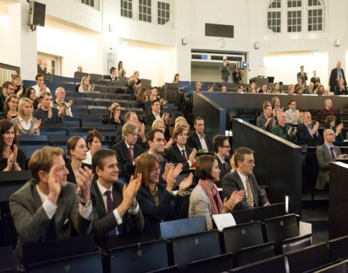
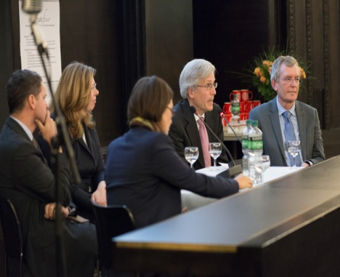
Graduation Party
WiSo-Graduate School
  Annually in May/June
  Place: Agathe-Lösch-lecture hall in the main building
  of the university
  Faculty honours graduates
  Music
  Graduation speech
  Champagne reception
  and snacks
Seite 26

